Slide 1
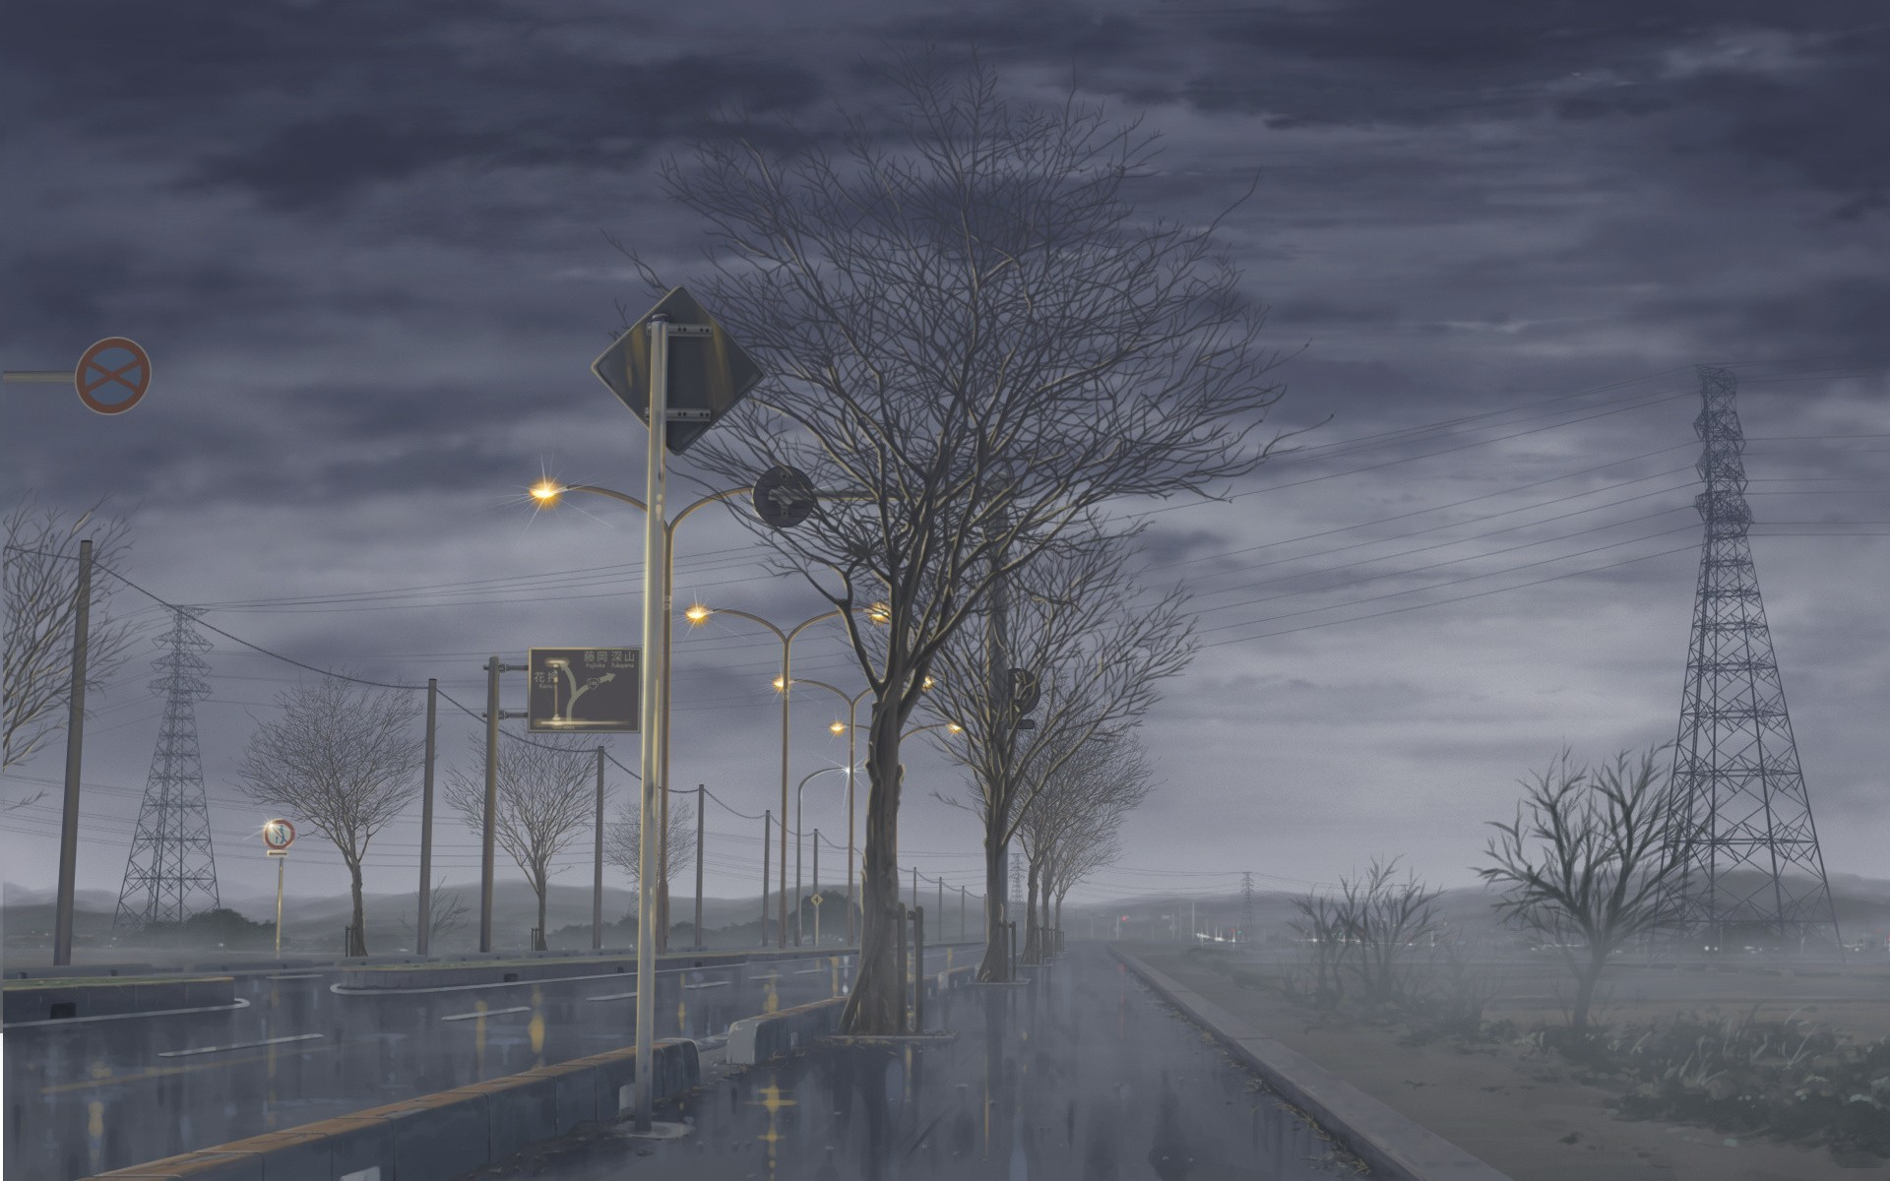
IMAGE DEHAZING
-Arushi

Slide 2
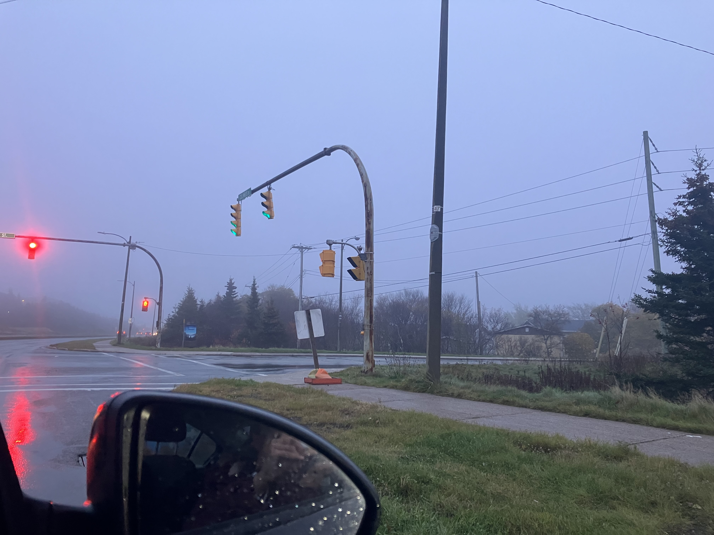
Why perform image dehazing?
Outdoor images are frequently affected by disturbances (e.g. fog, light scattering , smoke…)
This results in poor color fidelity, loss of contrast and affects depth perception
Computer vision algorithms assume accurate color, contrast and depth in input image
Hazy images affect performance of algorithms

Slide 3
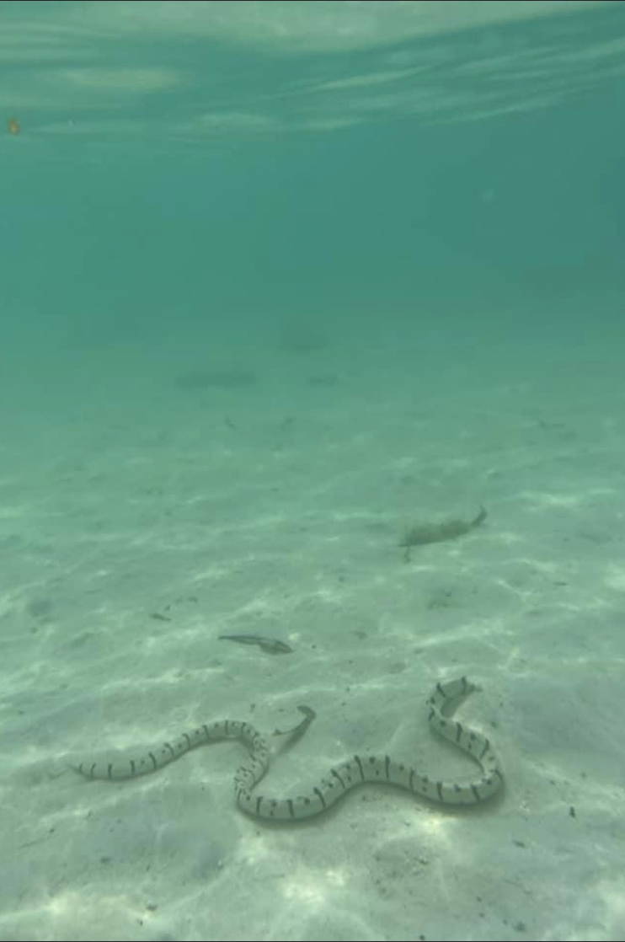
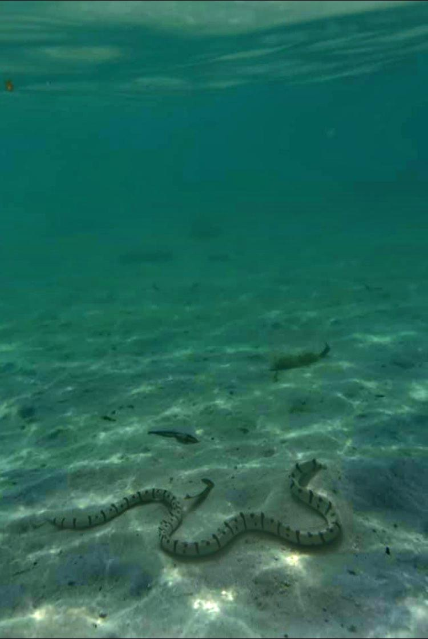

Slide 4
Single-image dehazing is a challenging problem!...Why?
To dehaze an image, we need to know the actual, ”real” color information (intensities, range, alpha channel…) of the landscape, without haze (i.e. the depth)
Which we do not have with just our hazy image!
Several methods proposed but I have been looking into dark-prior dehazing

Slide 5
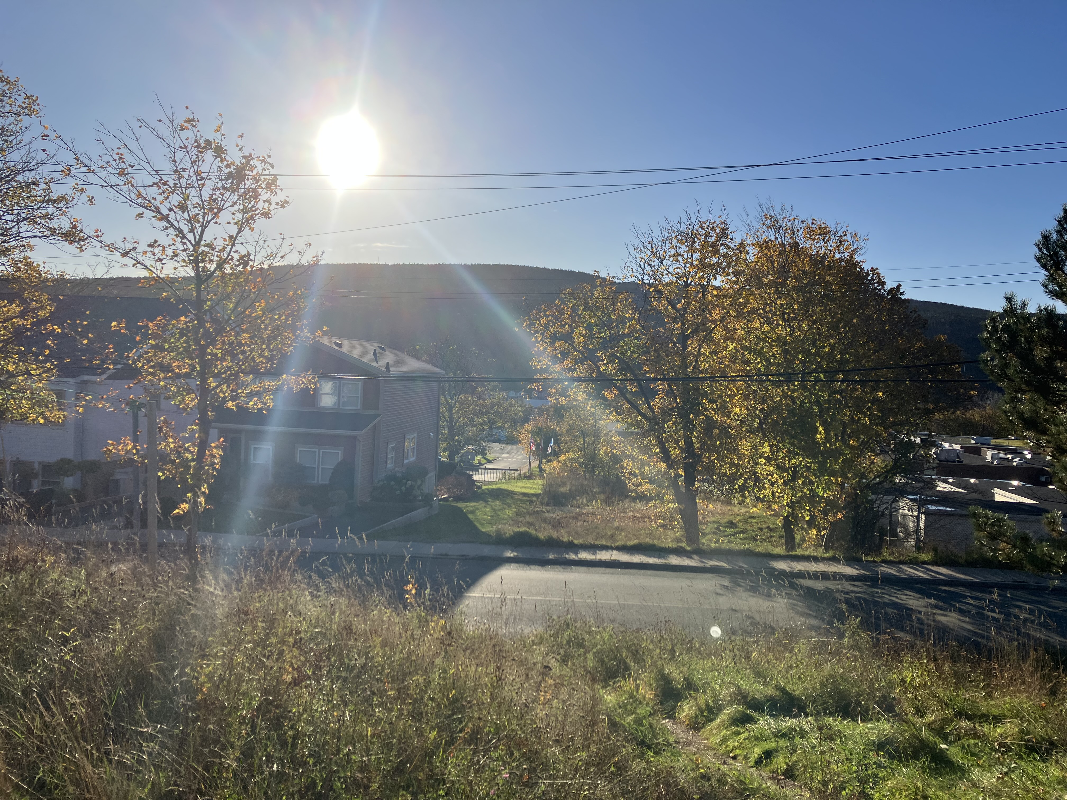




Dark prior dehazing method definition
p1 | p2 | p3
p4 | p5 | p6
p7 | p8 | p9
Patch
Based on statistical observation that when the patches (pixel neighborhood) of each pixel in the local area (everything but sky area) of a haze-free image is considered, there is at least one pixel in one of the color channels that has a very low intensity
Local area

Slide 6



Air light:
Scattered light causing color shift
Direct attenuation:
Scene radiance and its decay
I(x) = J(x)t(x) + A (1 – t(x))
Hazy input image
Scene radiance:
That is the actual amount of light radiated from scene (actual color information)
Global atmospheric light
Transmission:
Amount of light not scattered, reaches camera
Goal: To recover as much as J from A and t from I as possible

Slide 7
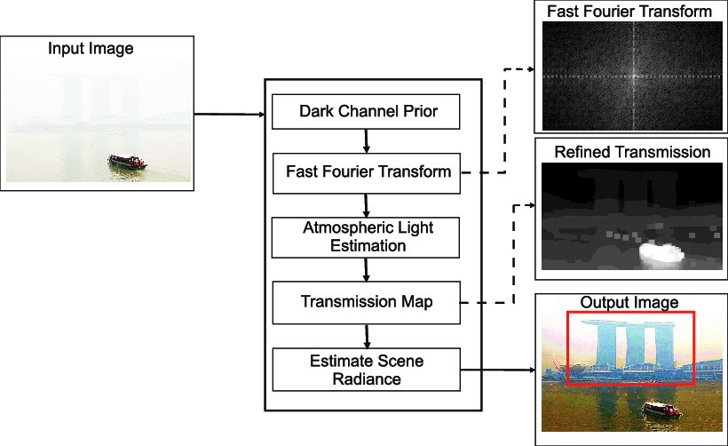
Dark prior dehazing Mechanism
Calculating dark prior (minimum of all color channels in every pixel in a patch)
Calculate air light (scattered light-causes color shift)
a) Select brightest pixels in dark
prior
b)From those pixels, select the
ones with highest intensities in
the input image
3. Calculate transmission (amount of
light reaching camera)
Blur the transmission map
Recover image using formula
After step 3 and 4
*Pictures in this slide are not mine!

Slide 8
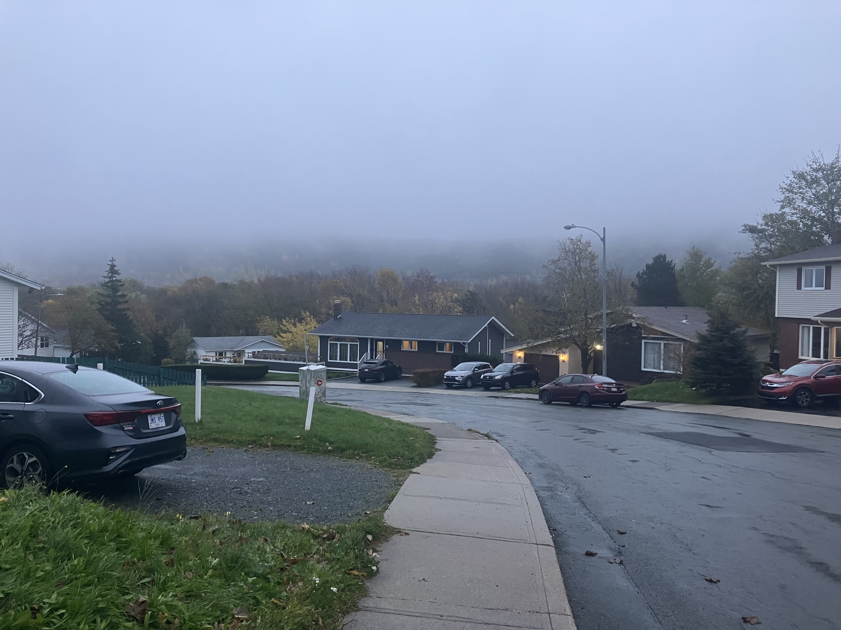
Issues with Dark prior dehazing
Oversaturation in output image if a smaller patch size is used

Slide 9
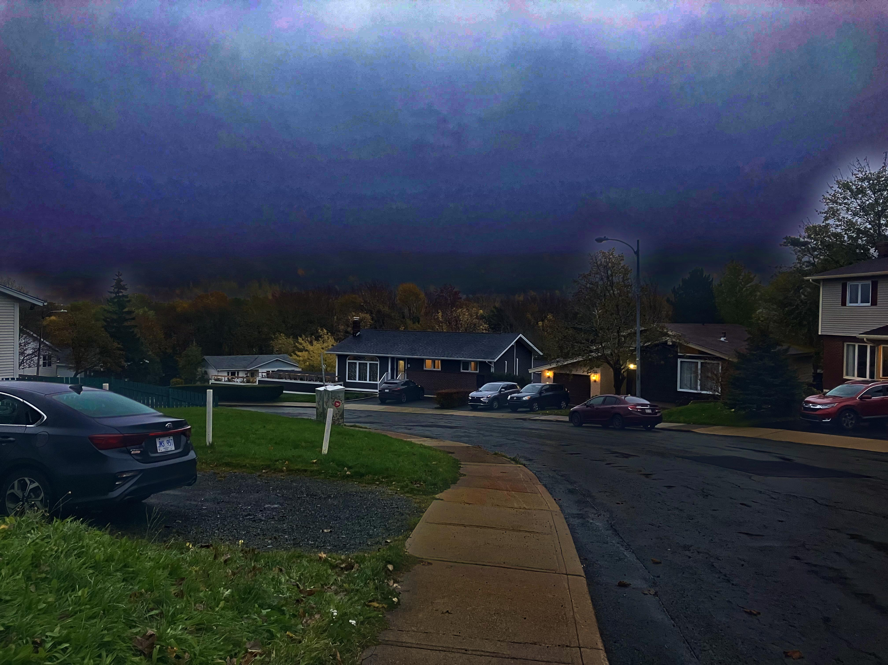
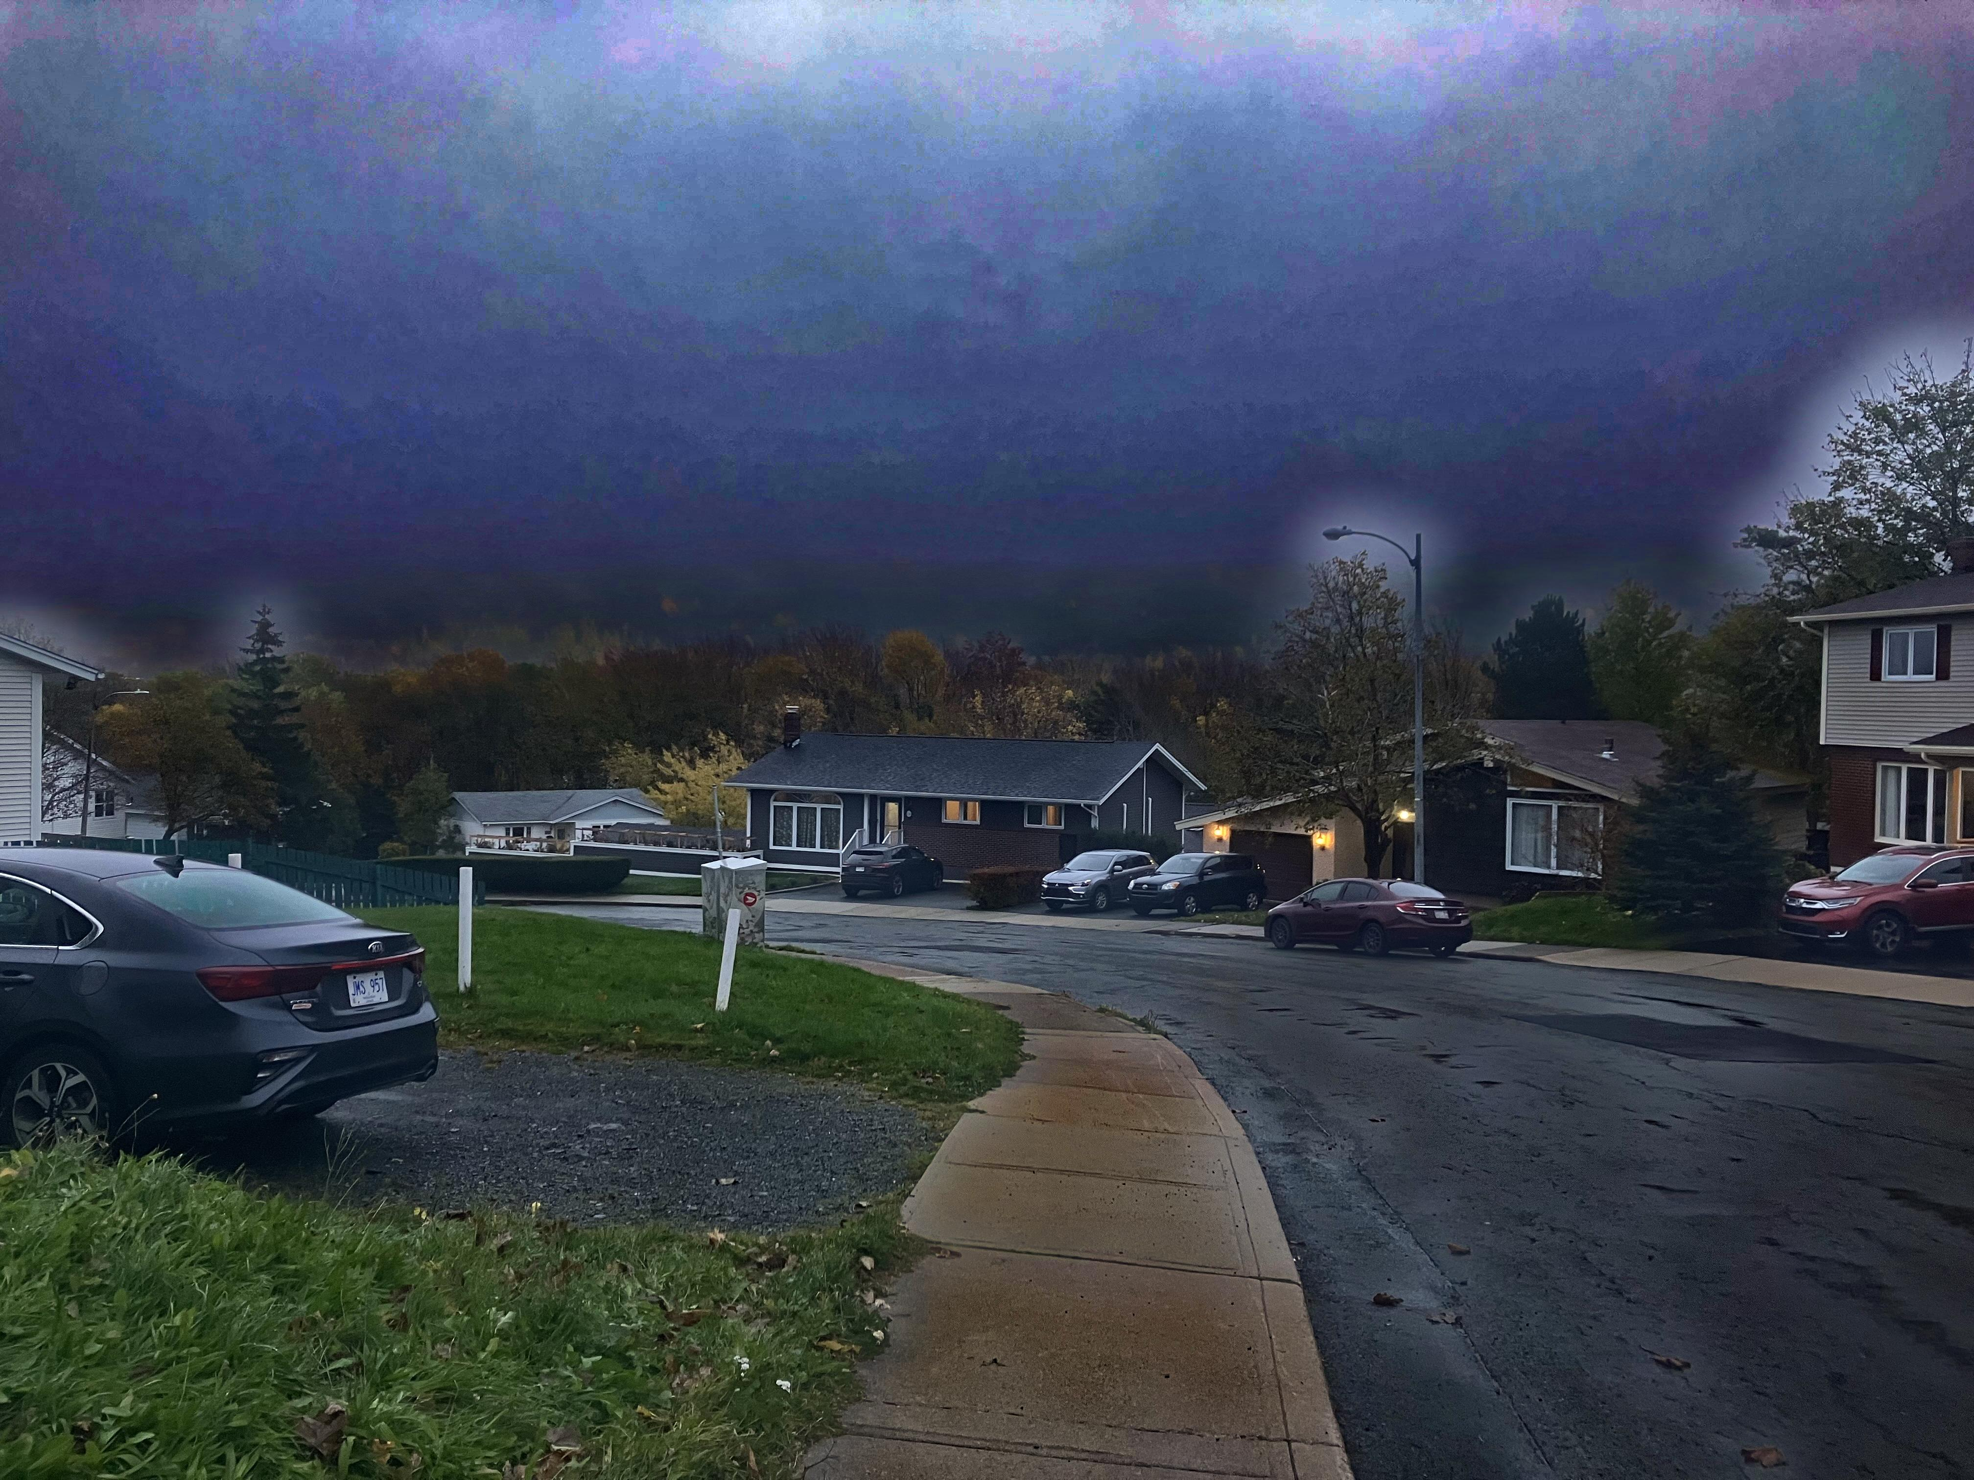
Patch size = 3 x 3
Patch size 14 X 14

Slide 11
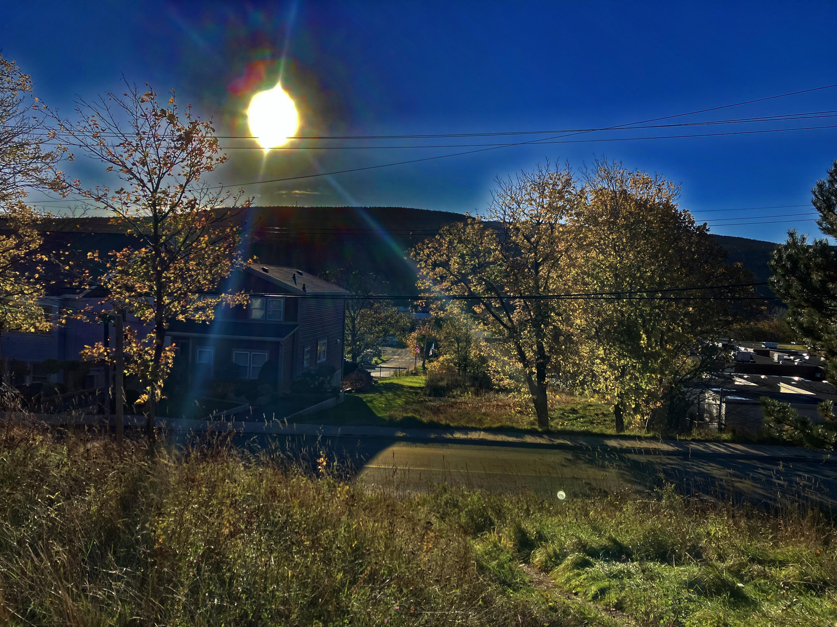
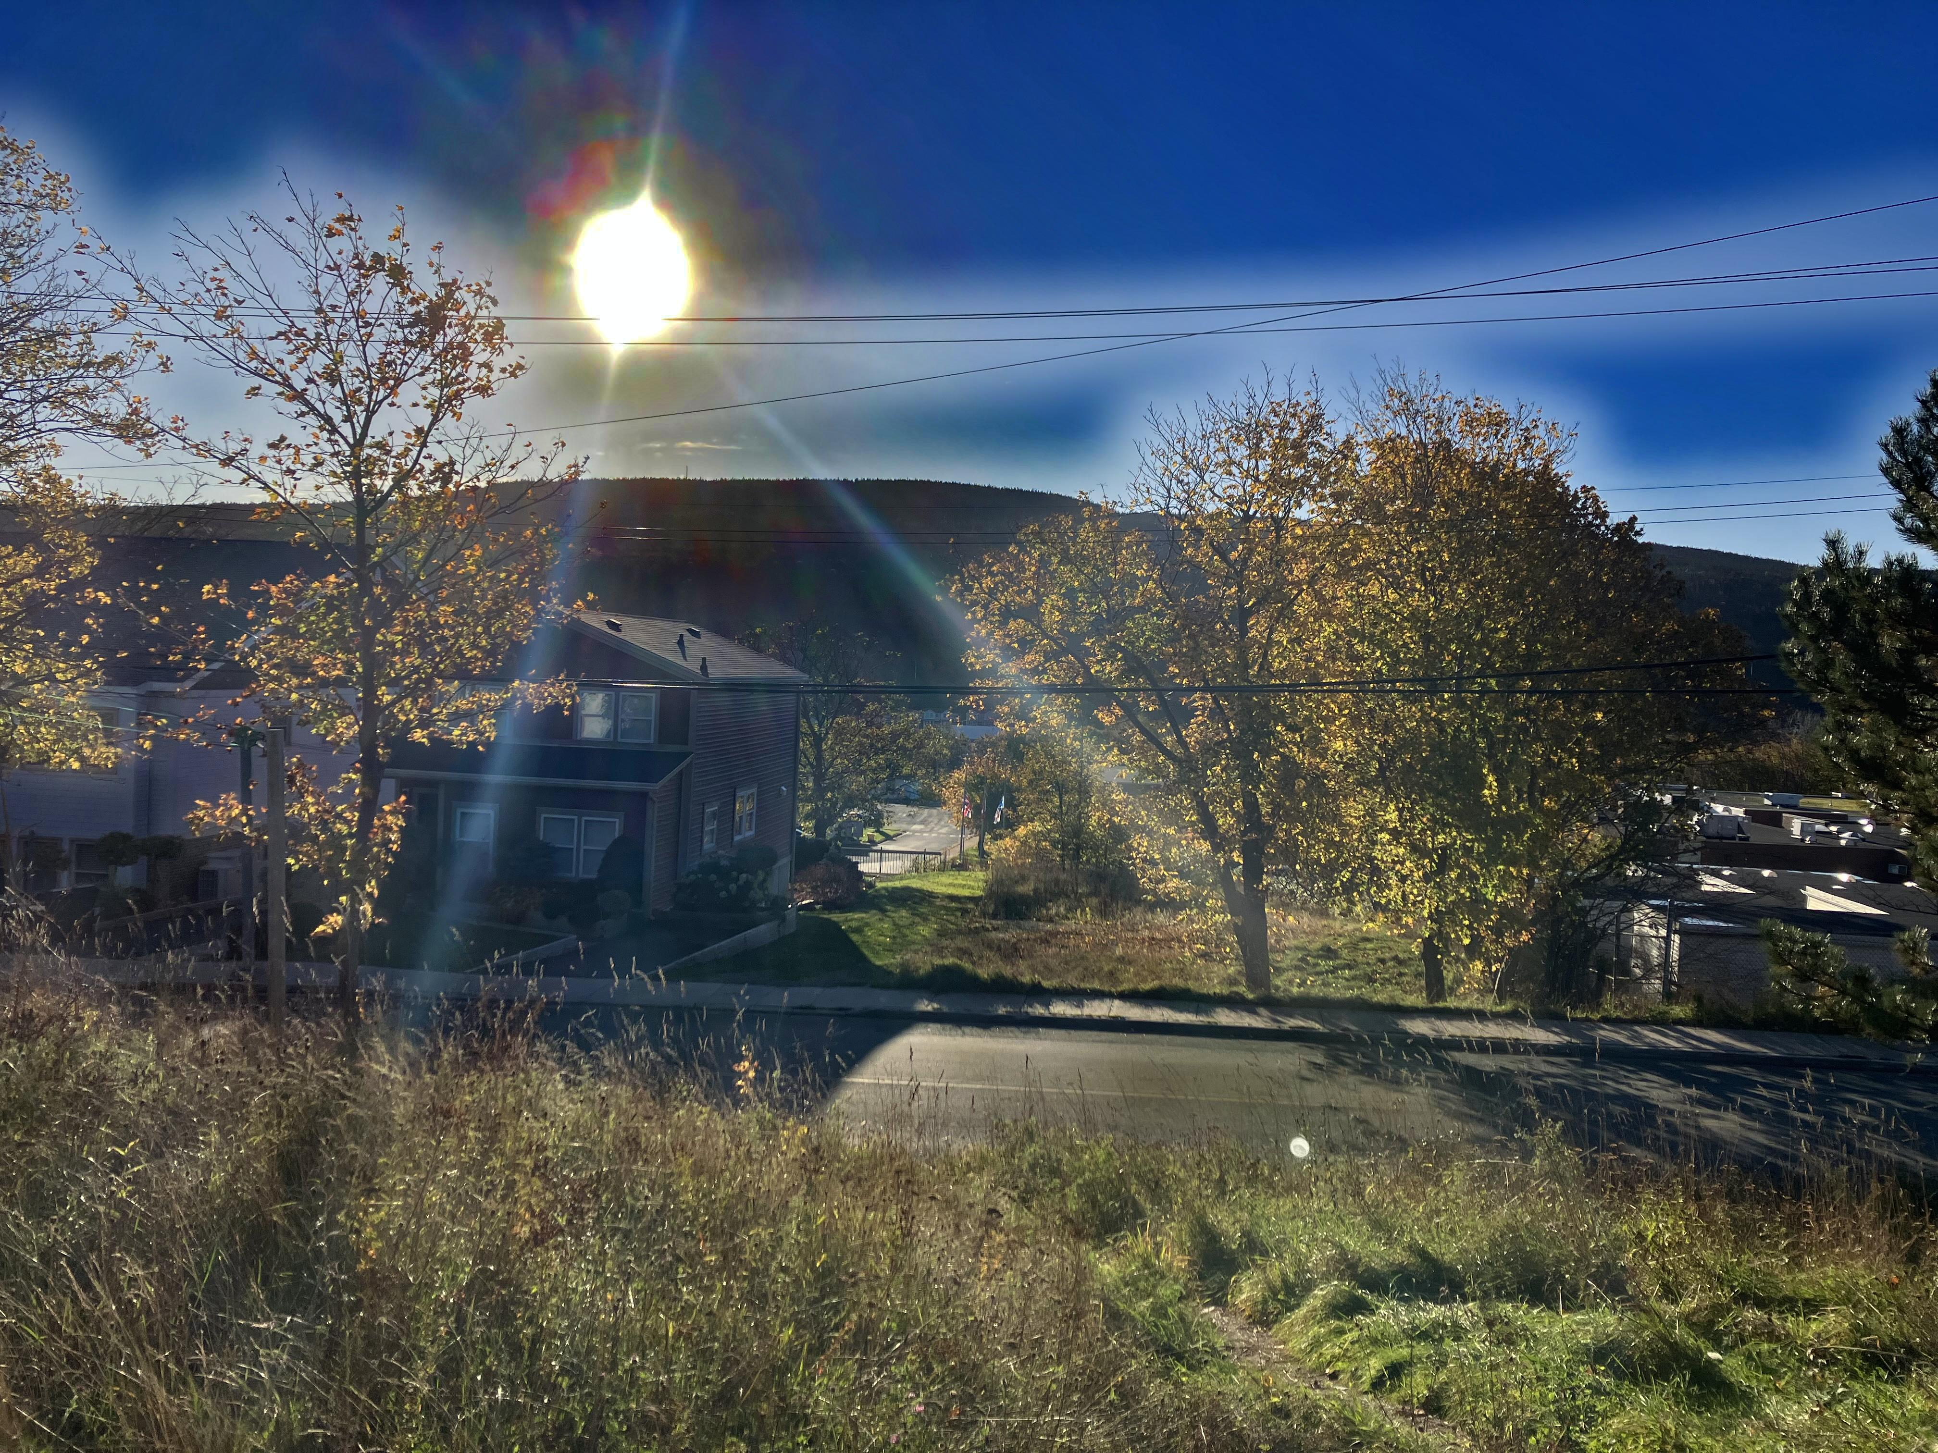
Patch size = 3 x 3
Patch size 14 X 14

Slide 12
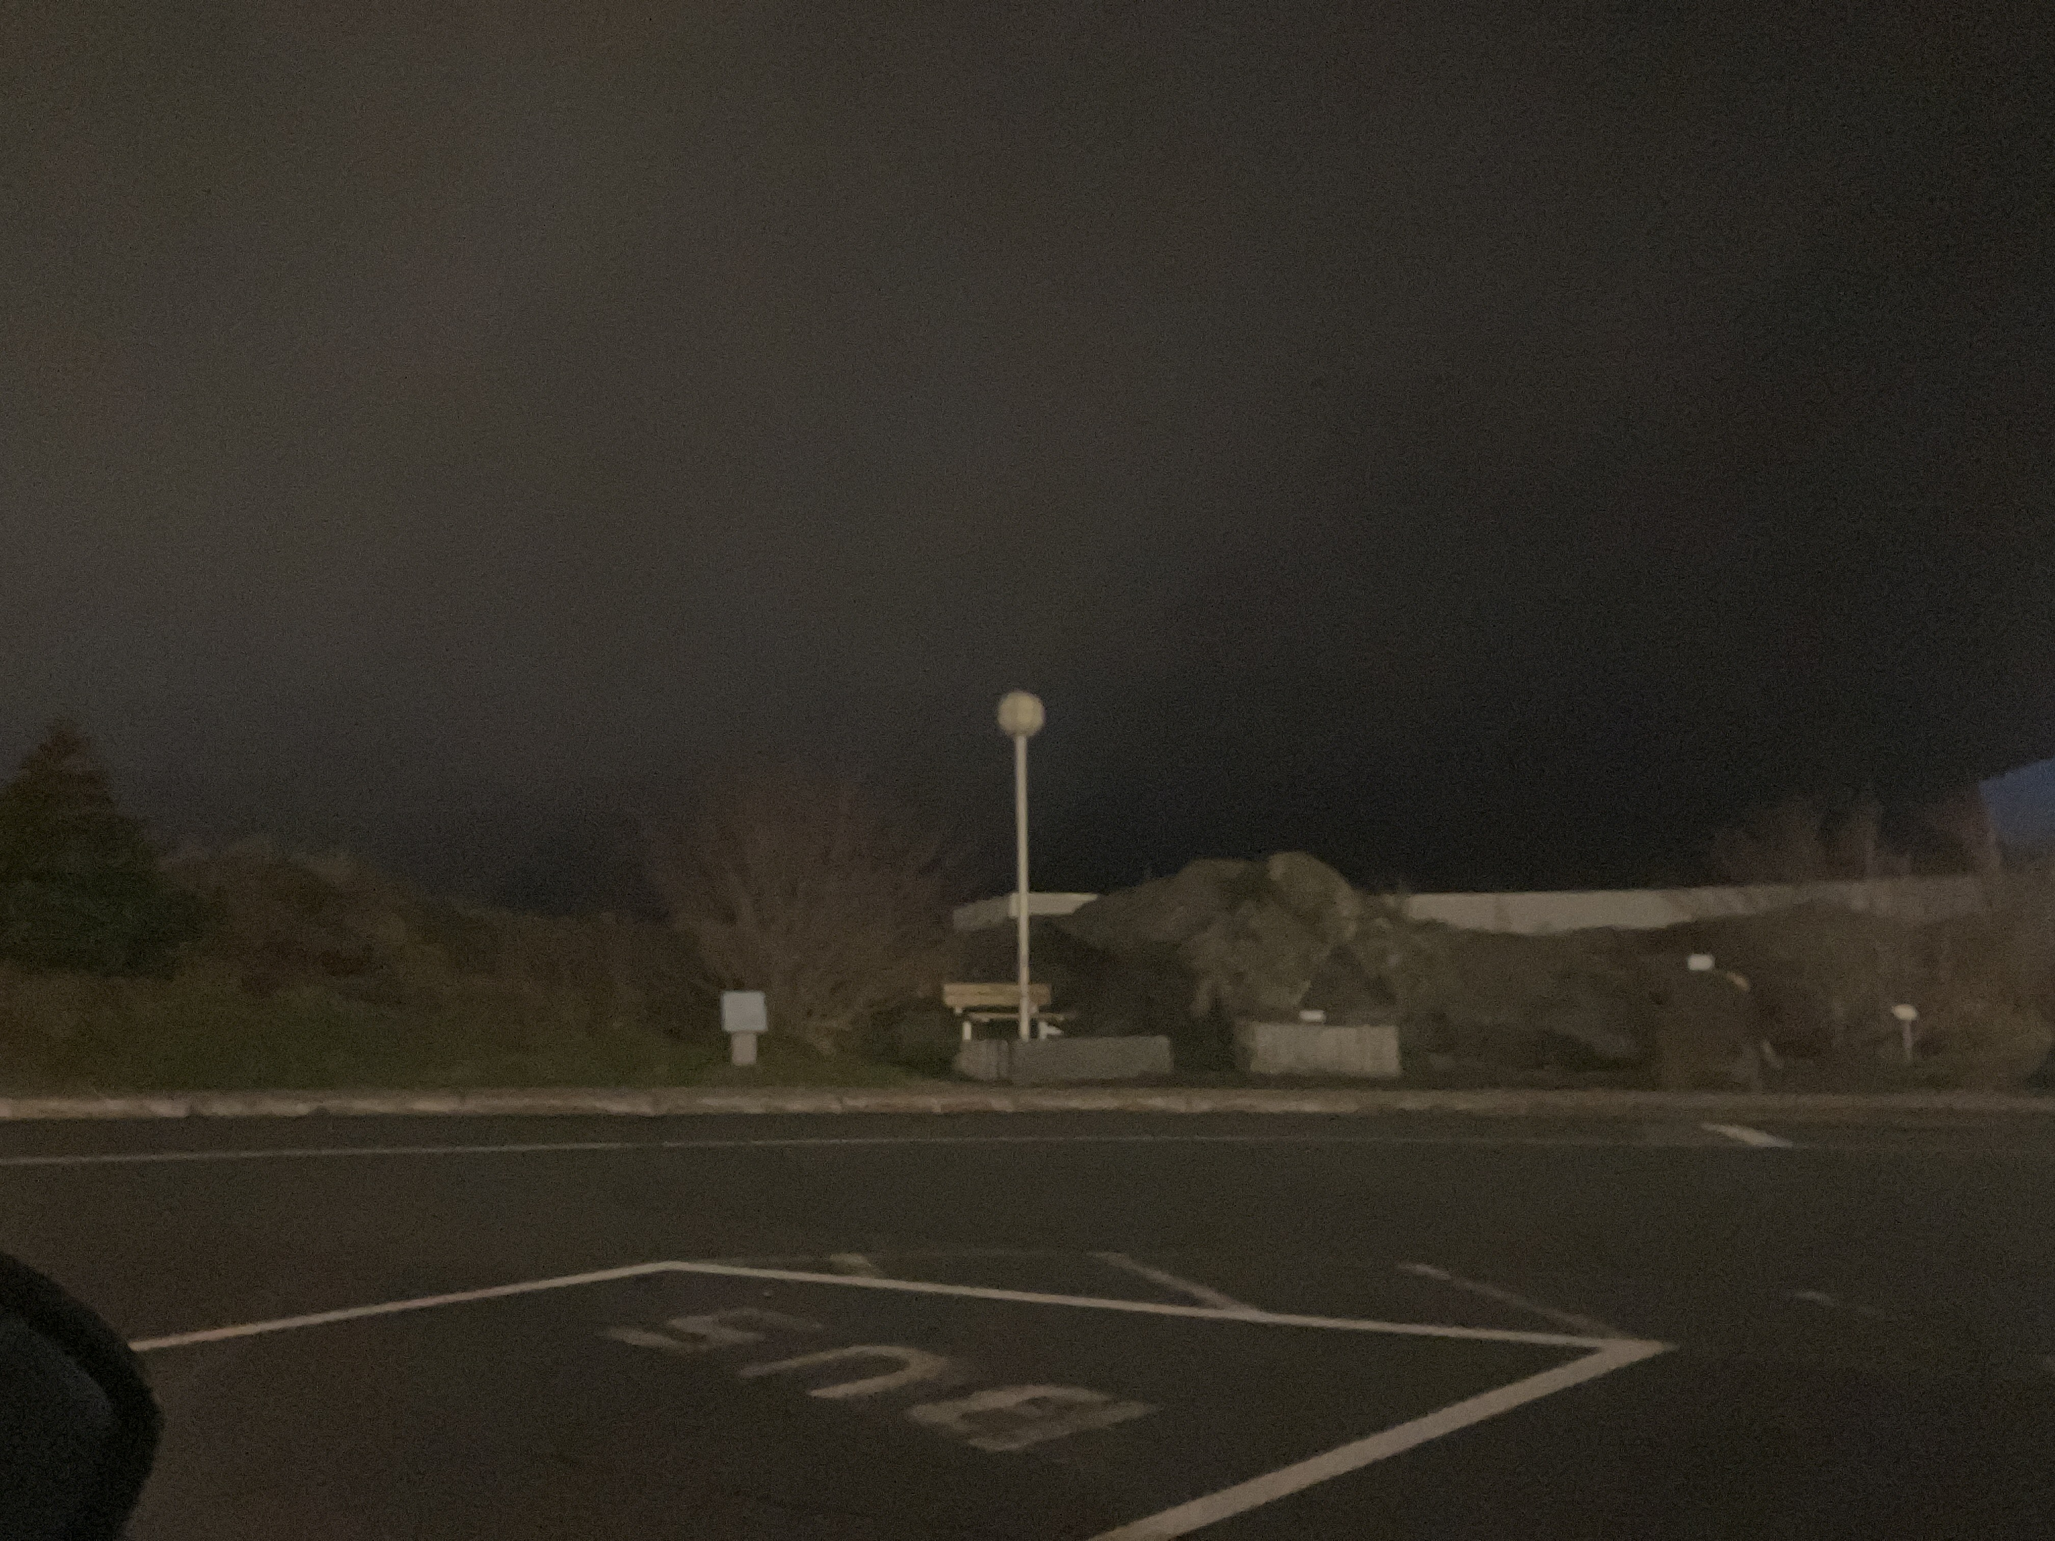

Slide 13
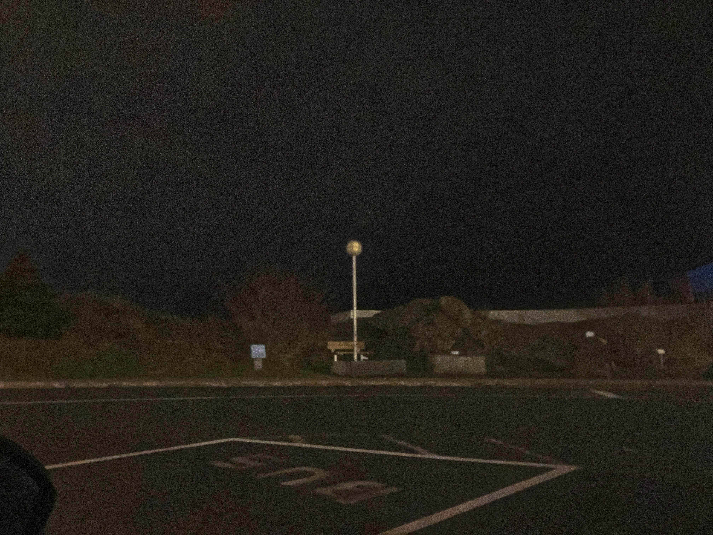
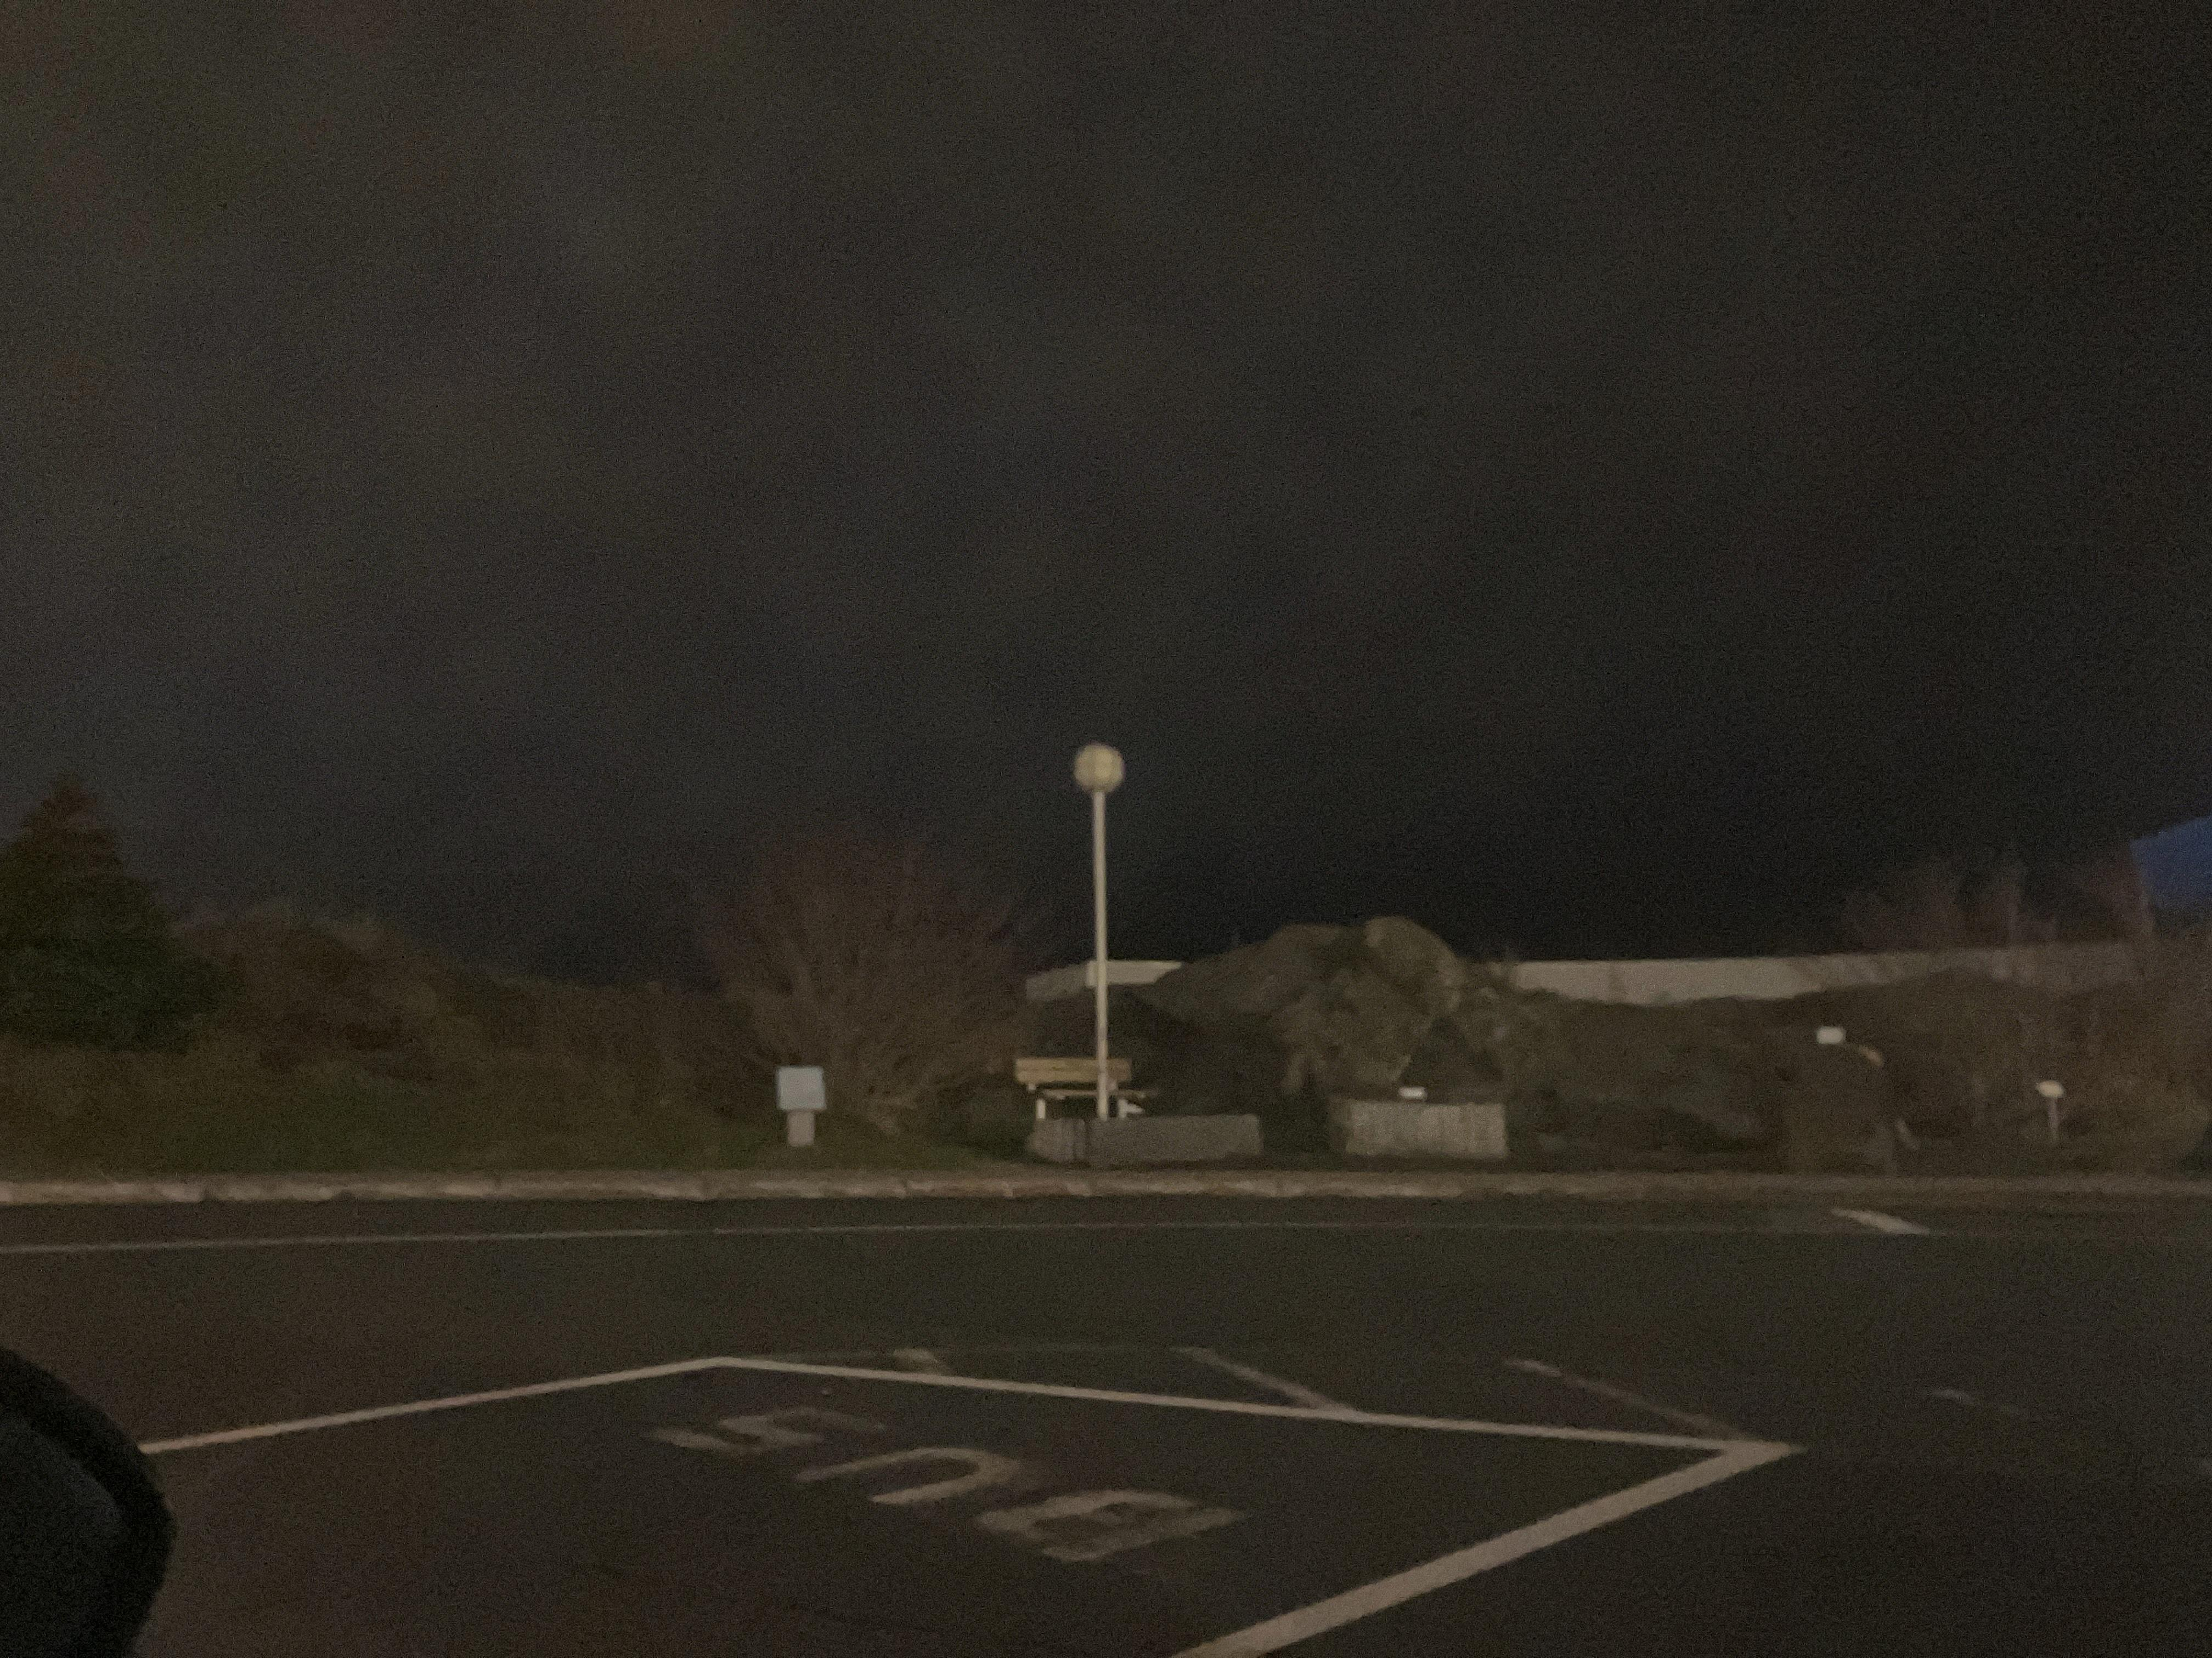
Patch size = 7 x 7
Patch size = 28 x 28

Slide 14
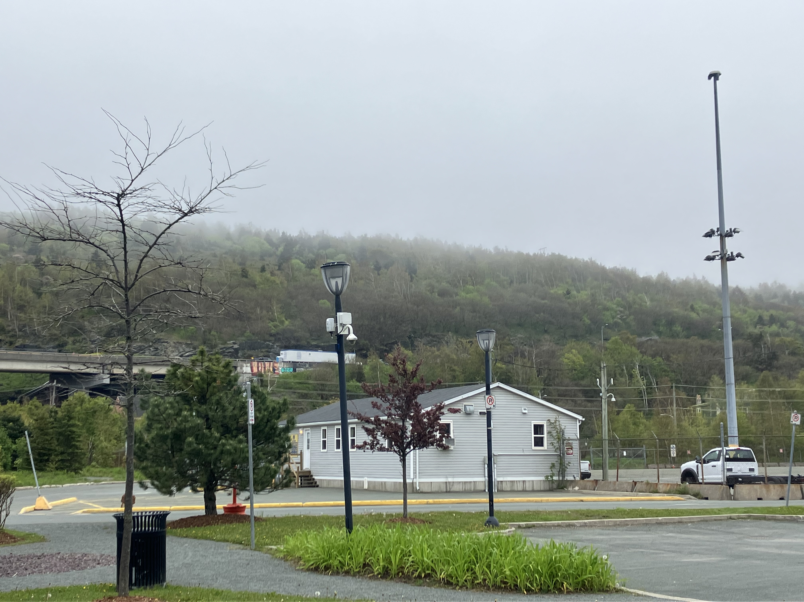
Issues with Dark prior dehazing
Halo effects when smoothing filter uses larger kernel
Hazy imageinput

Slide 15
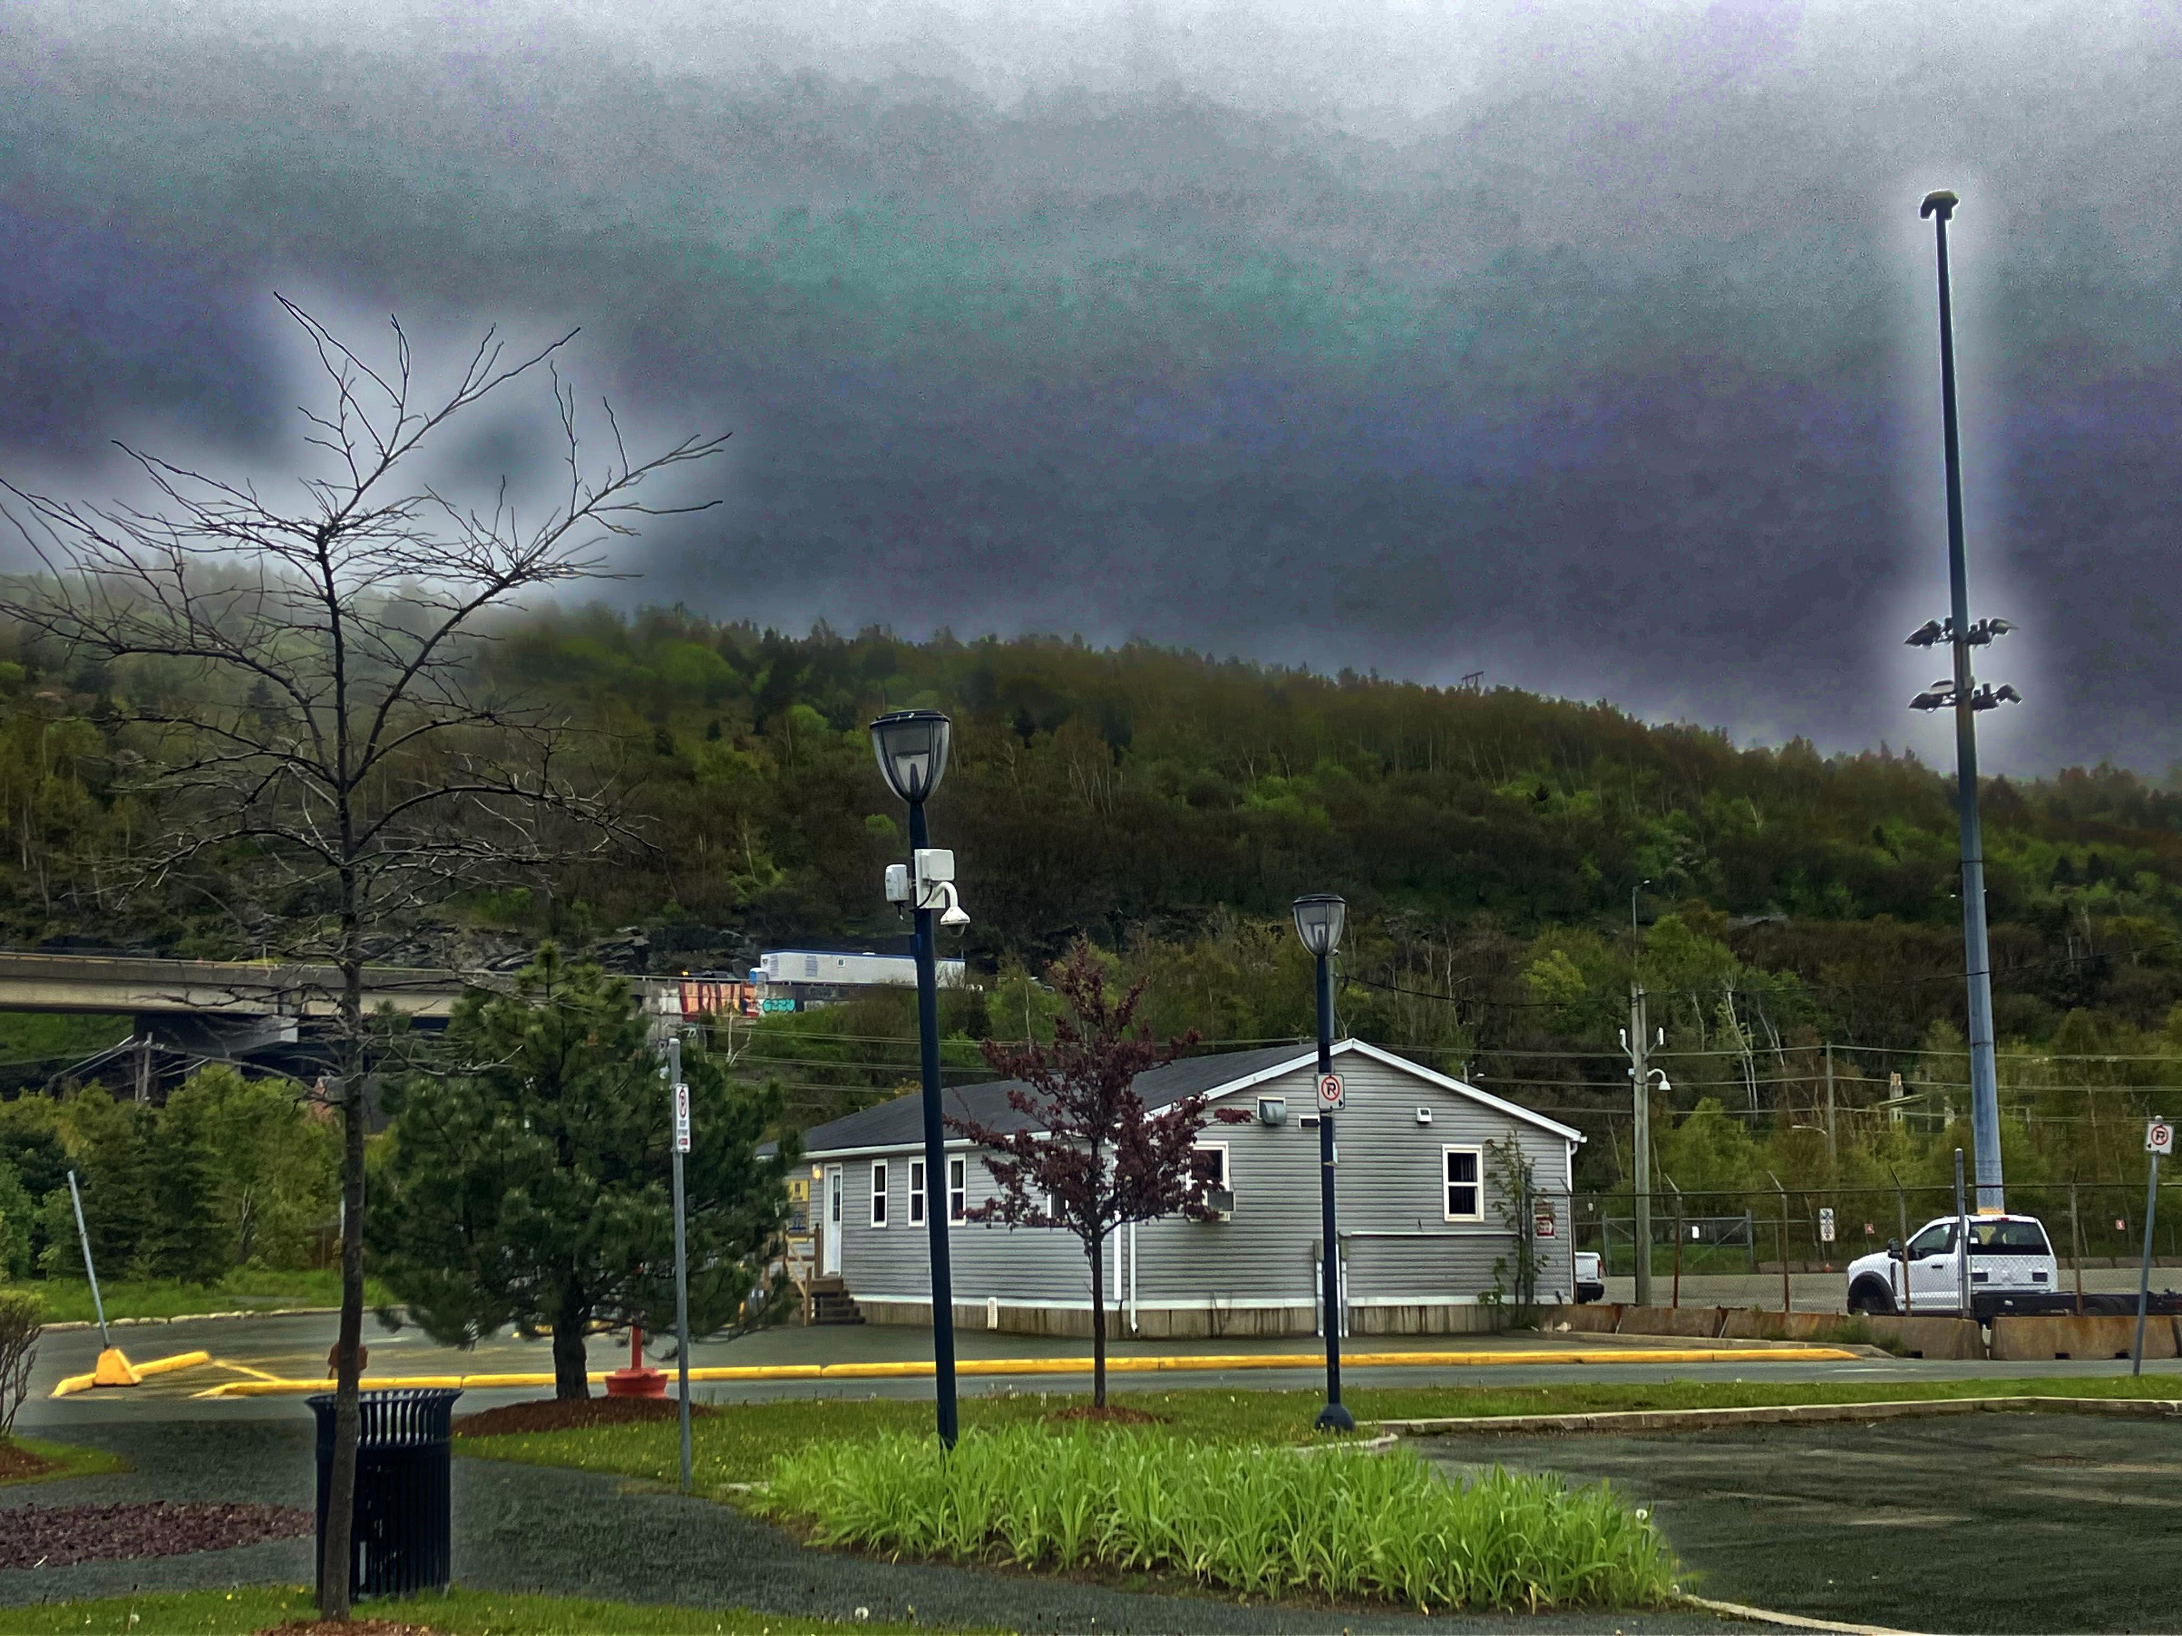
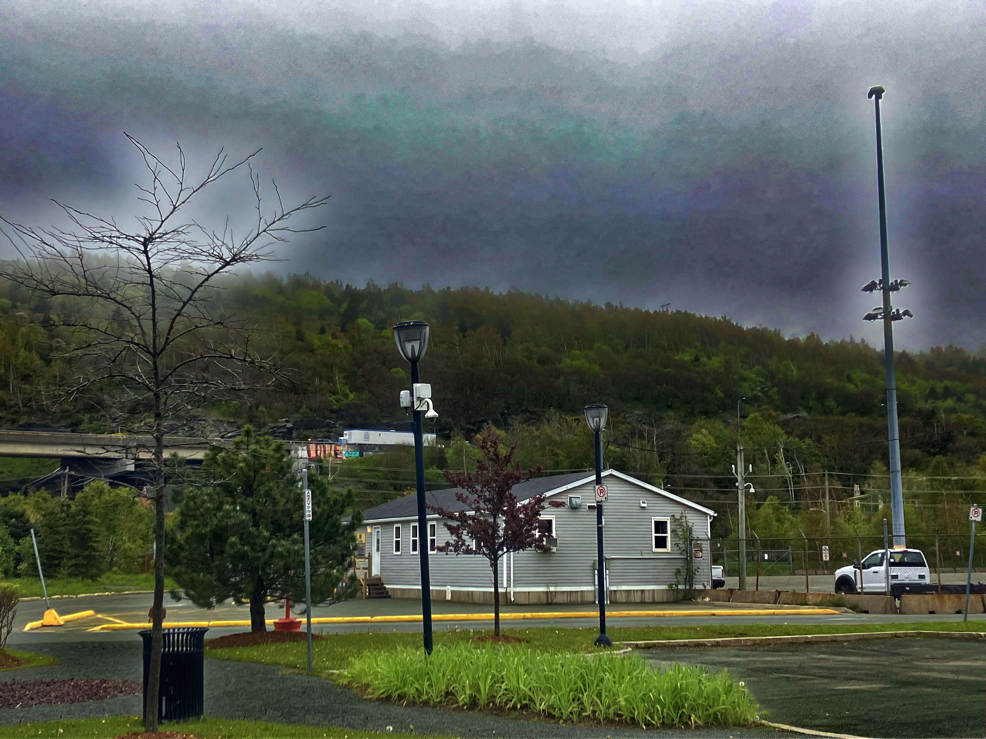
Guided filter 60 X 60
Guided filter 100 X 100

Slide 16
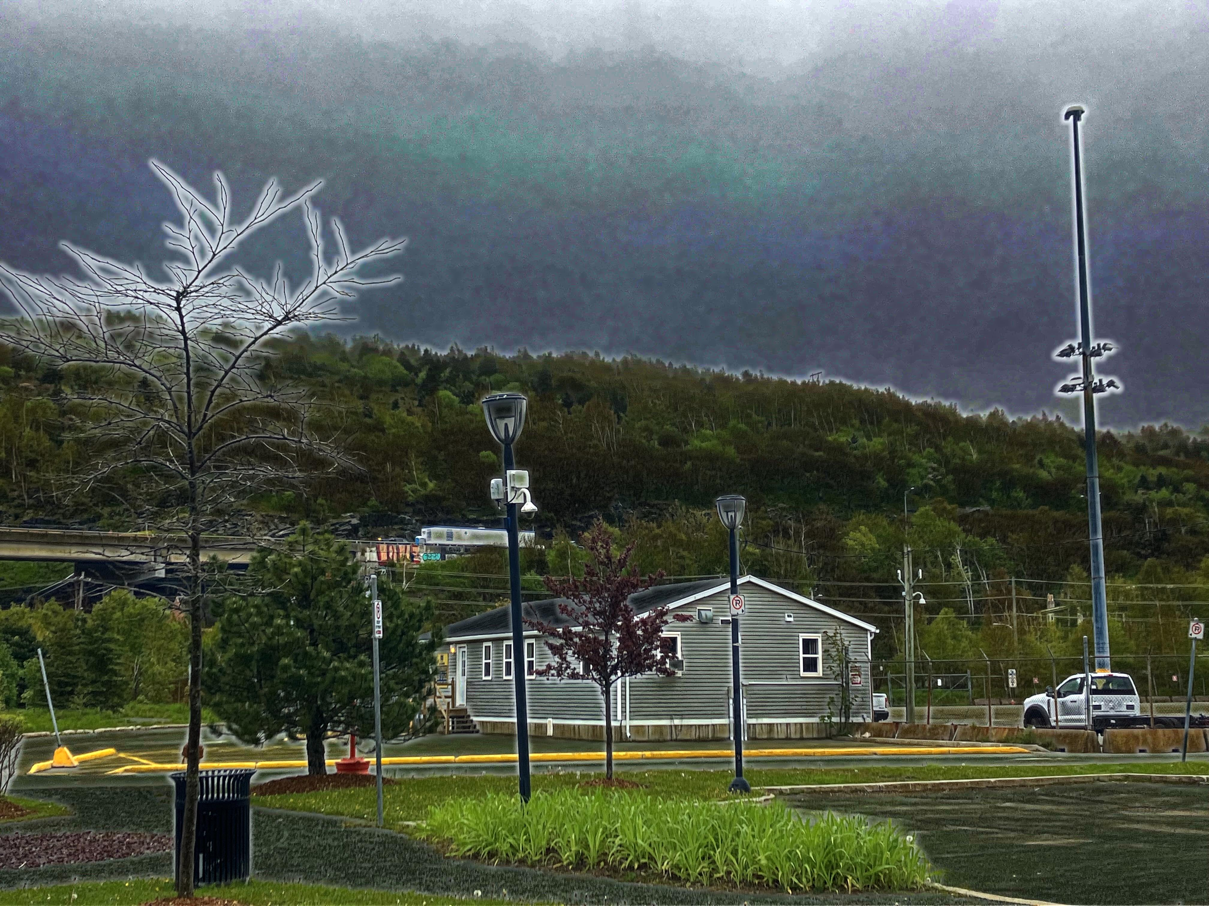
Guided filter 60 X 60

Slide 17
Guided filter 80 X 80

Slide 18
Guided filter 100 X 100

Slide 19
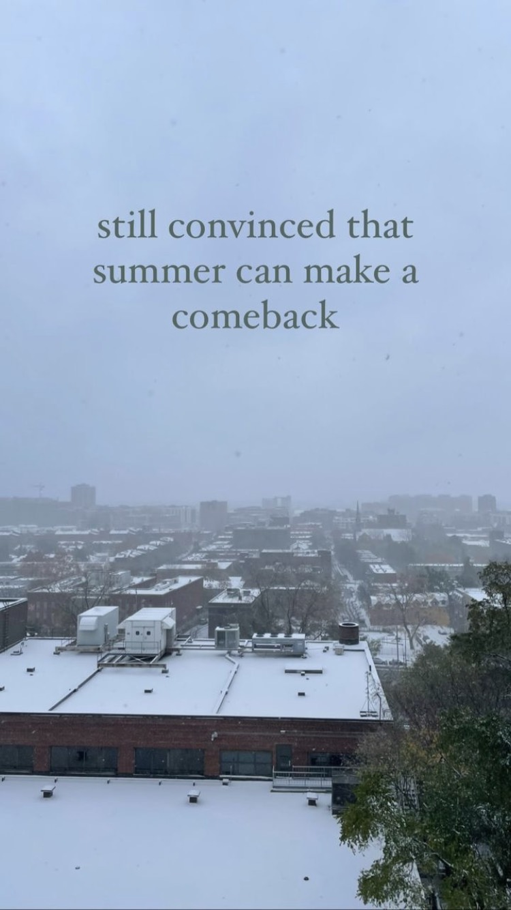
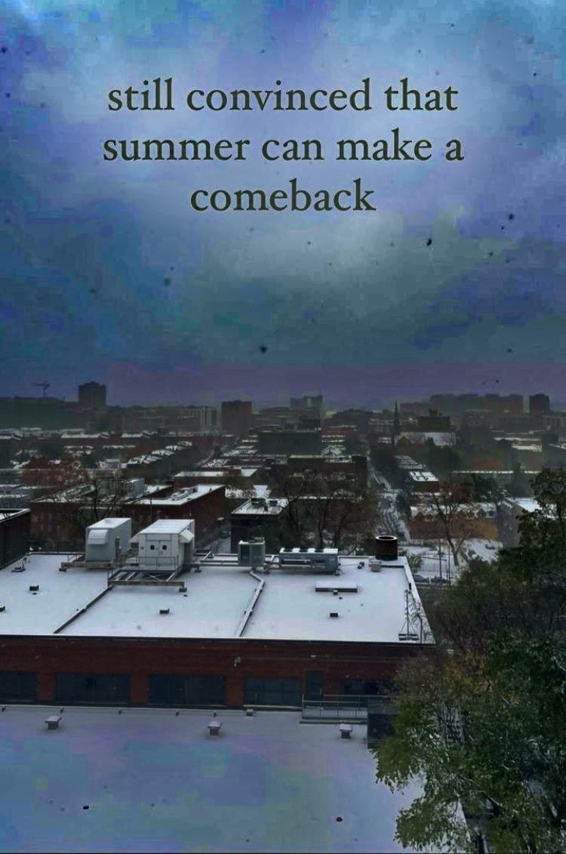
Issues with Dark prior dehazing
Does not work well with landscapes where air light is similar to features and shadows in local area are minimal (e.g. snowy landscapes
*Pictures in this slide are not mine!

